Slide 1

Predicting the impact on Stock Market with Current Trade Tariff Announcements
Saakshi Dedhia, Saumya Jhaveri, Xinqi Li, and Siyu Chen
Professor Matthew Delventhal - ECON 570
May 1st, 2025

Slide 2
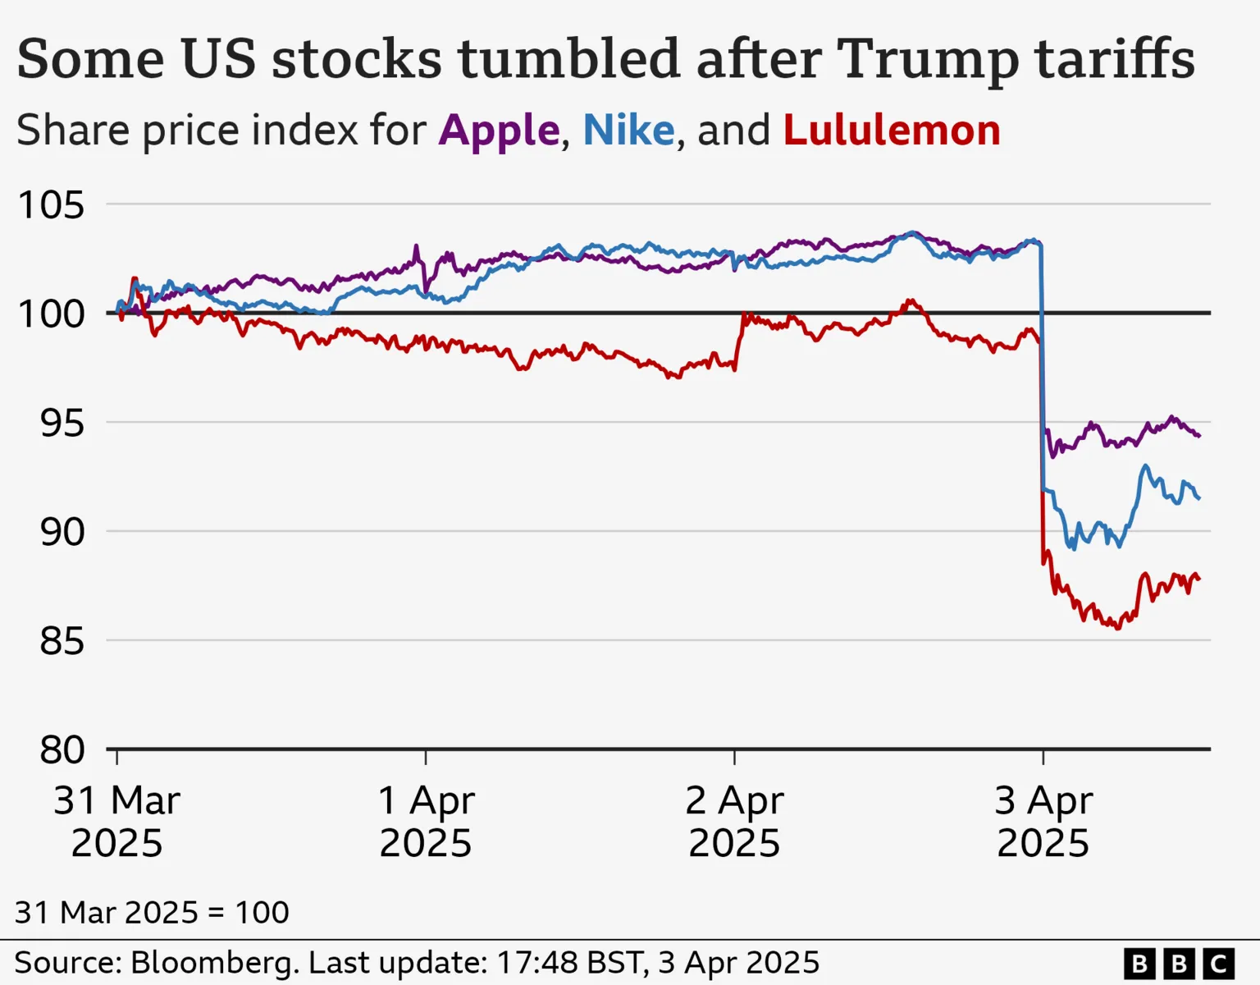
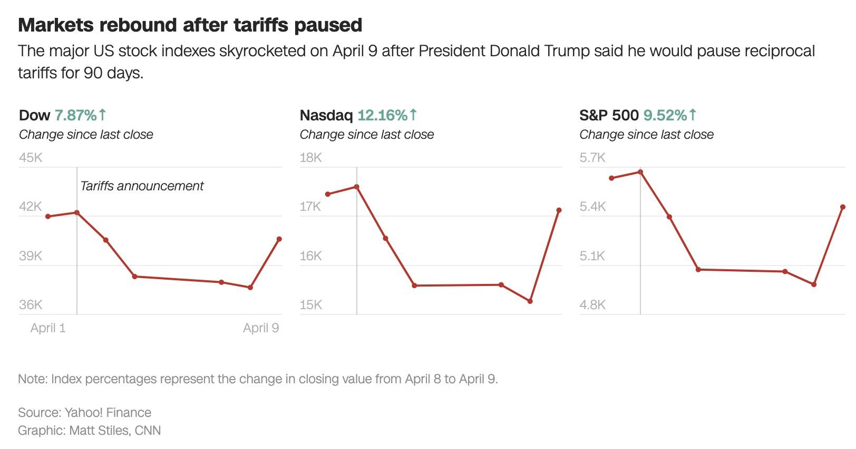

Intro: Background
Tariff policies trigger sharp and immediate market reactions

Slide 3
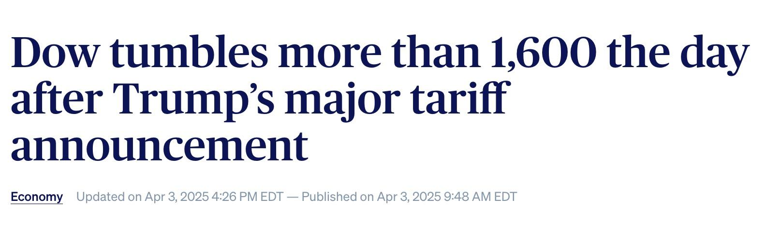
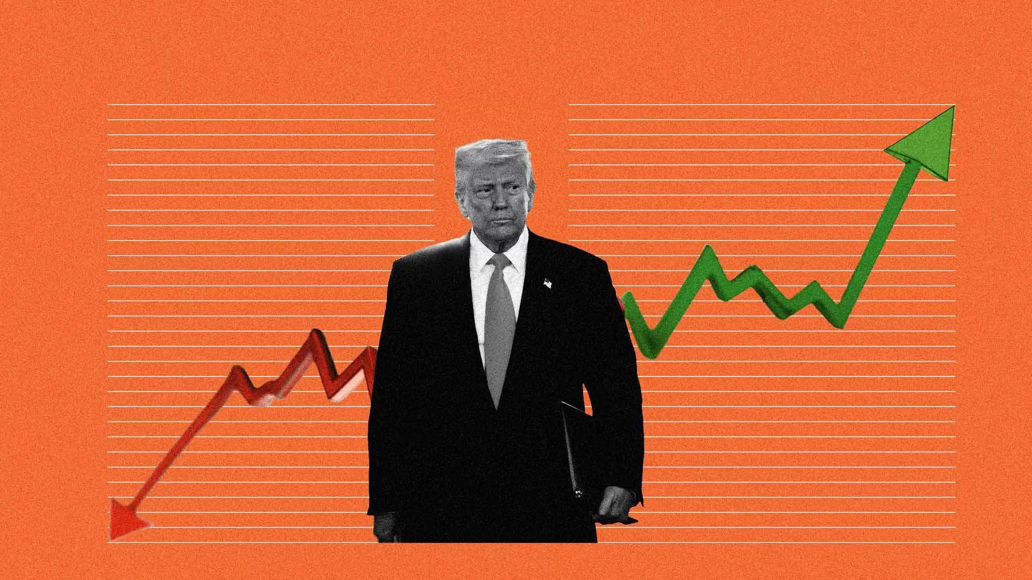
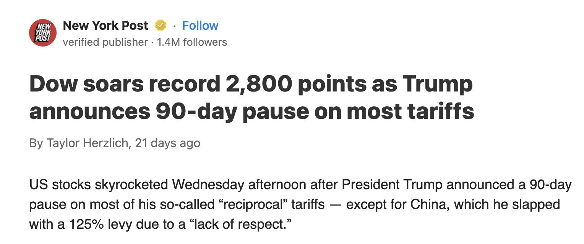
Intro: Background
Can financial news sentiment predict short-term stock returns?

Slide 4
Motivation
From Policy Shocks to Predictive Signals: Our Research Goal
Understand how markets react to major policy news — not just what is said, but how it’s said.
Use FinBERT to extract sentiment from news and speeches.
Test if this sentiment can predict short-term stock and ETF changes.
We use machine learning models like LASSO, XGBoost, and Random Forest on high-frequency stock data.

Slide 5
Literature Review
Key Research Findings
Study | Method | Key Finding
Zou & Herremans (2022) | FinBERT vs. basic sentiment | FinBERT performs better than traditional models
Gu et al. (2024) | FinBERT-LSTM on NASDAQ | Predicts market movement with 95%+ accuracy
Shobayo et al. (2024) | GPT-4 & FinBERT embeddings | Outperforms keyword scoring in sentiment classification

Slide 6
Our Contribution - Methodology
Event based model
Trump-era tariffs - sentiment impact
707 articles - ETF and stock data
Finbert embeddings (LASSO/XGBoost) + sentiment scores
News → FinBERT Features → LASSO/XGBoost → Prediction

Slide 7
Data Collection
3/31 - 4/19
Stock Market Data:
i. Company-Level (hourly):
14 firms across Technology, Industrials, Consumer Discretionary
Data from Alpha Vantage API
ii. ETF-Level (Minute-level):
SPY, XLI, DIA
Data from LSEG Workspace
b. News Data: EventRegistry.org
Keyword: “Trump speech”
Full article bodies - Python scraping using BeautifulSoup
Total Scraped: 707 articles

Slide 8
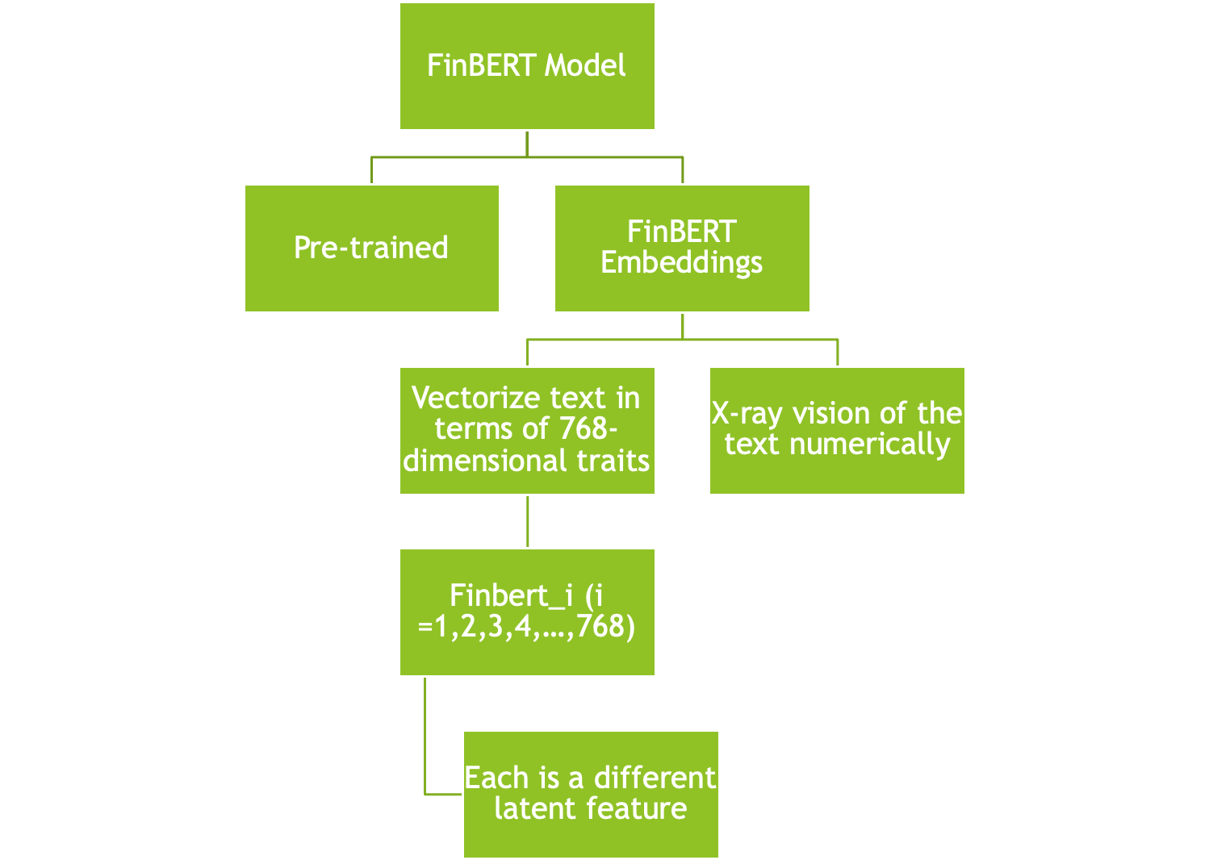

Slide 9
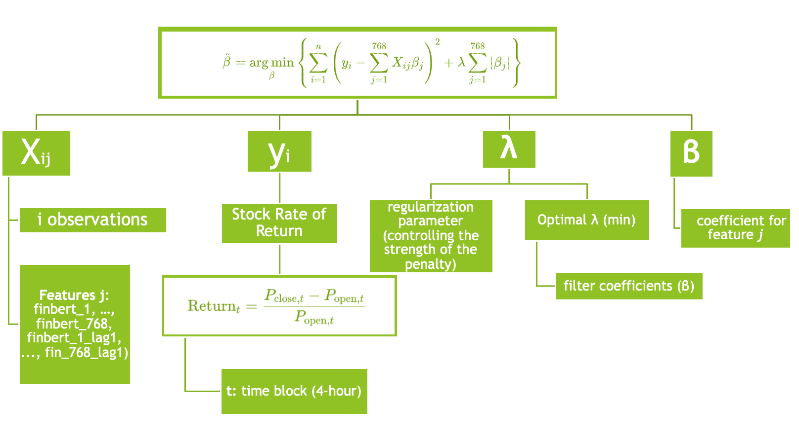
Company-level Analysis-LASSO

Slide 10
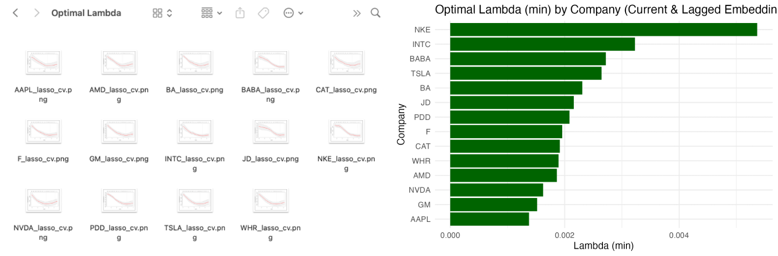
Company-level Analysis-LASSO
Cross-Validation Curves of Companies Selected (MSE vs Log λ)

Slide 11
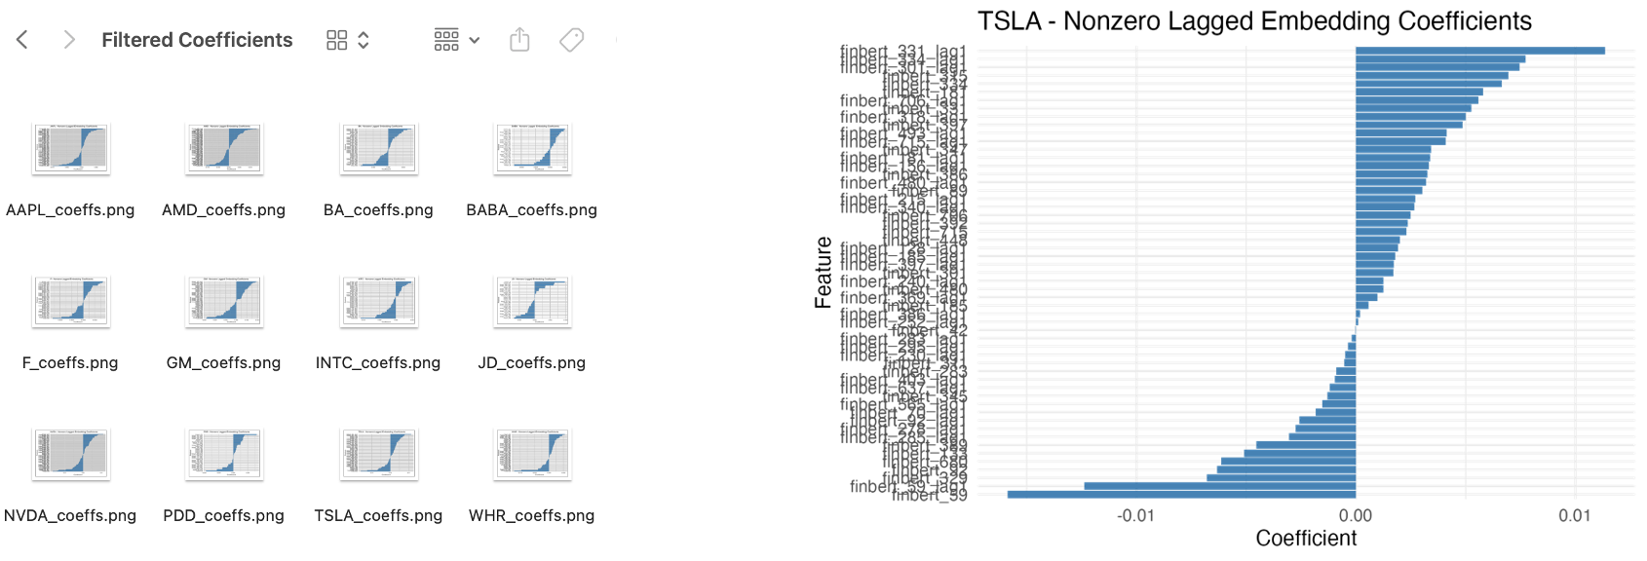
Company-level Analysis-LASSO

Slide 12
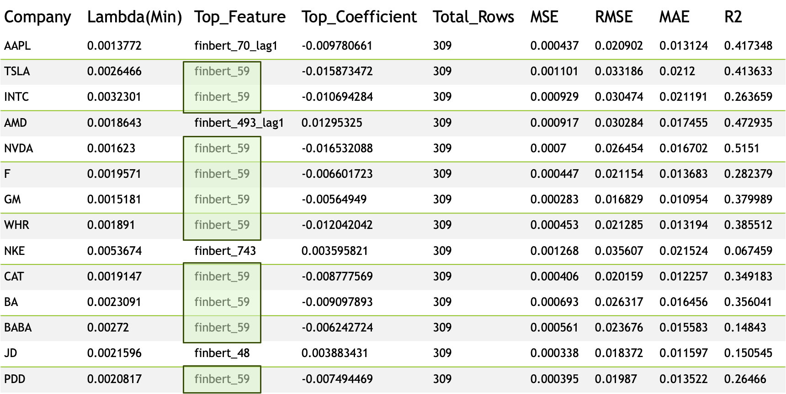

Slide 13
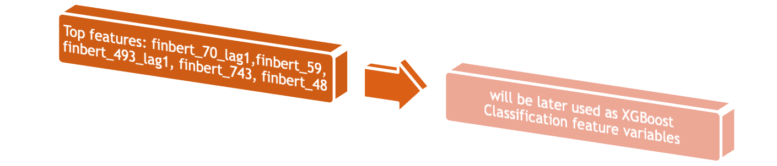
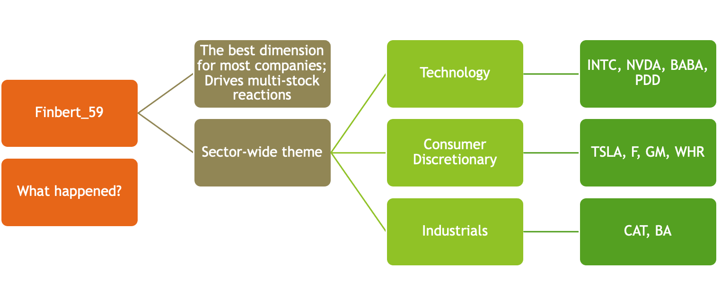
Company-level Analysis-LASSO

Slide 14
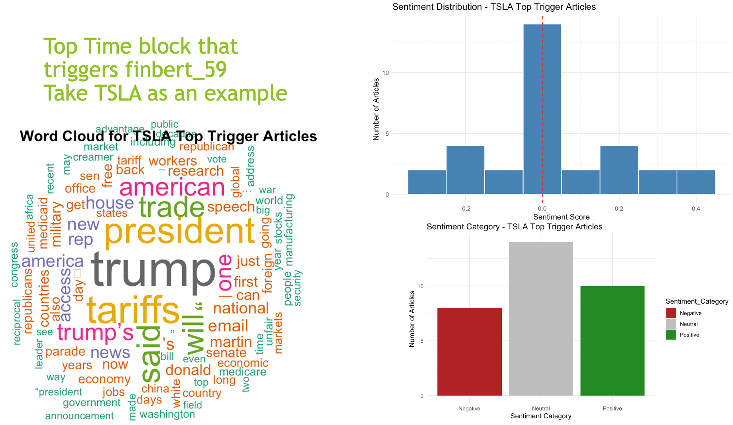

Slide 15
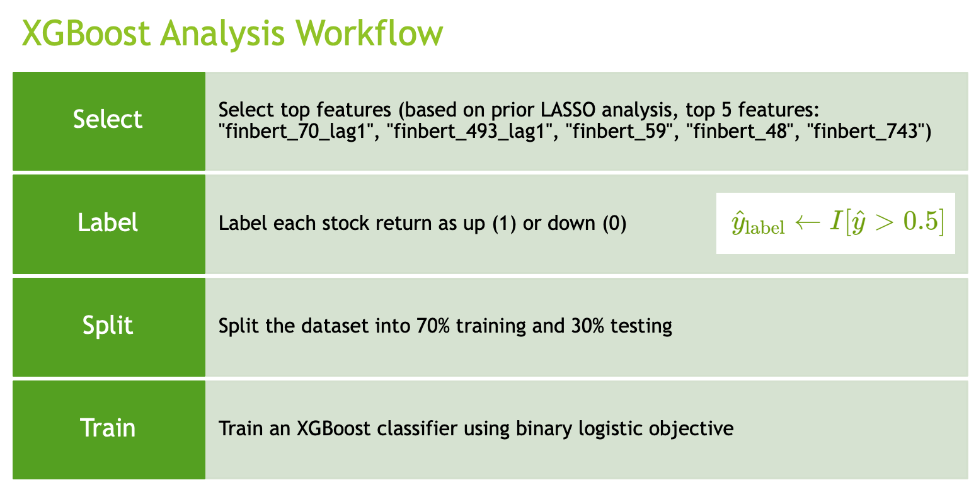
Company-level Analysis-XGBoost

Slide 16
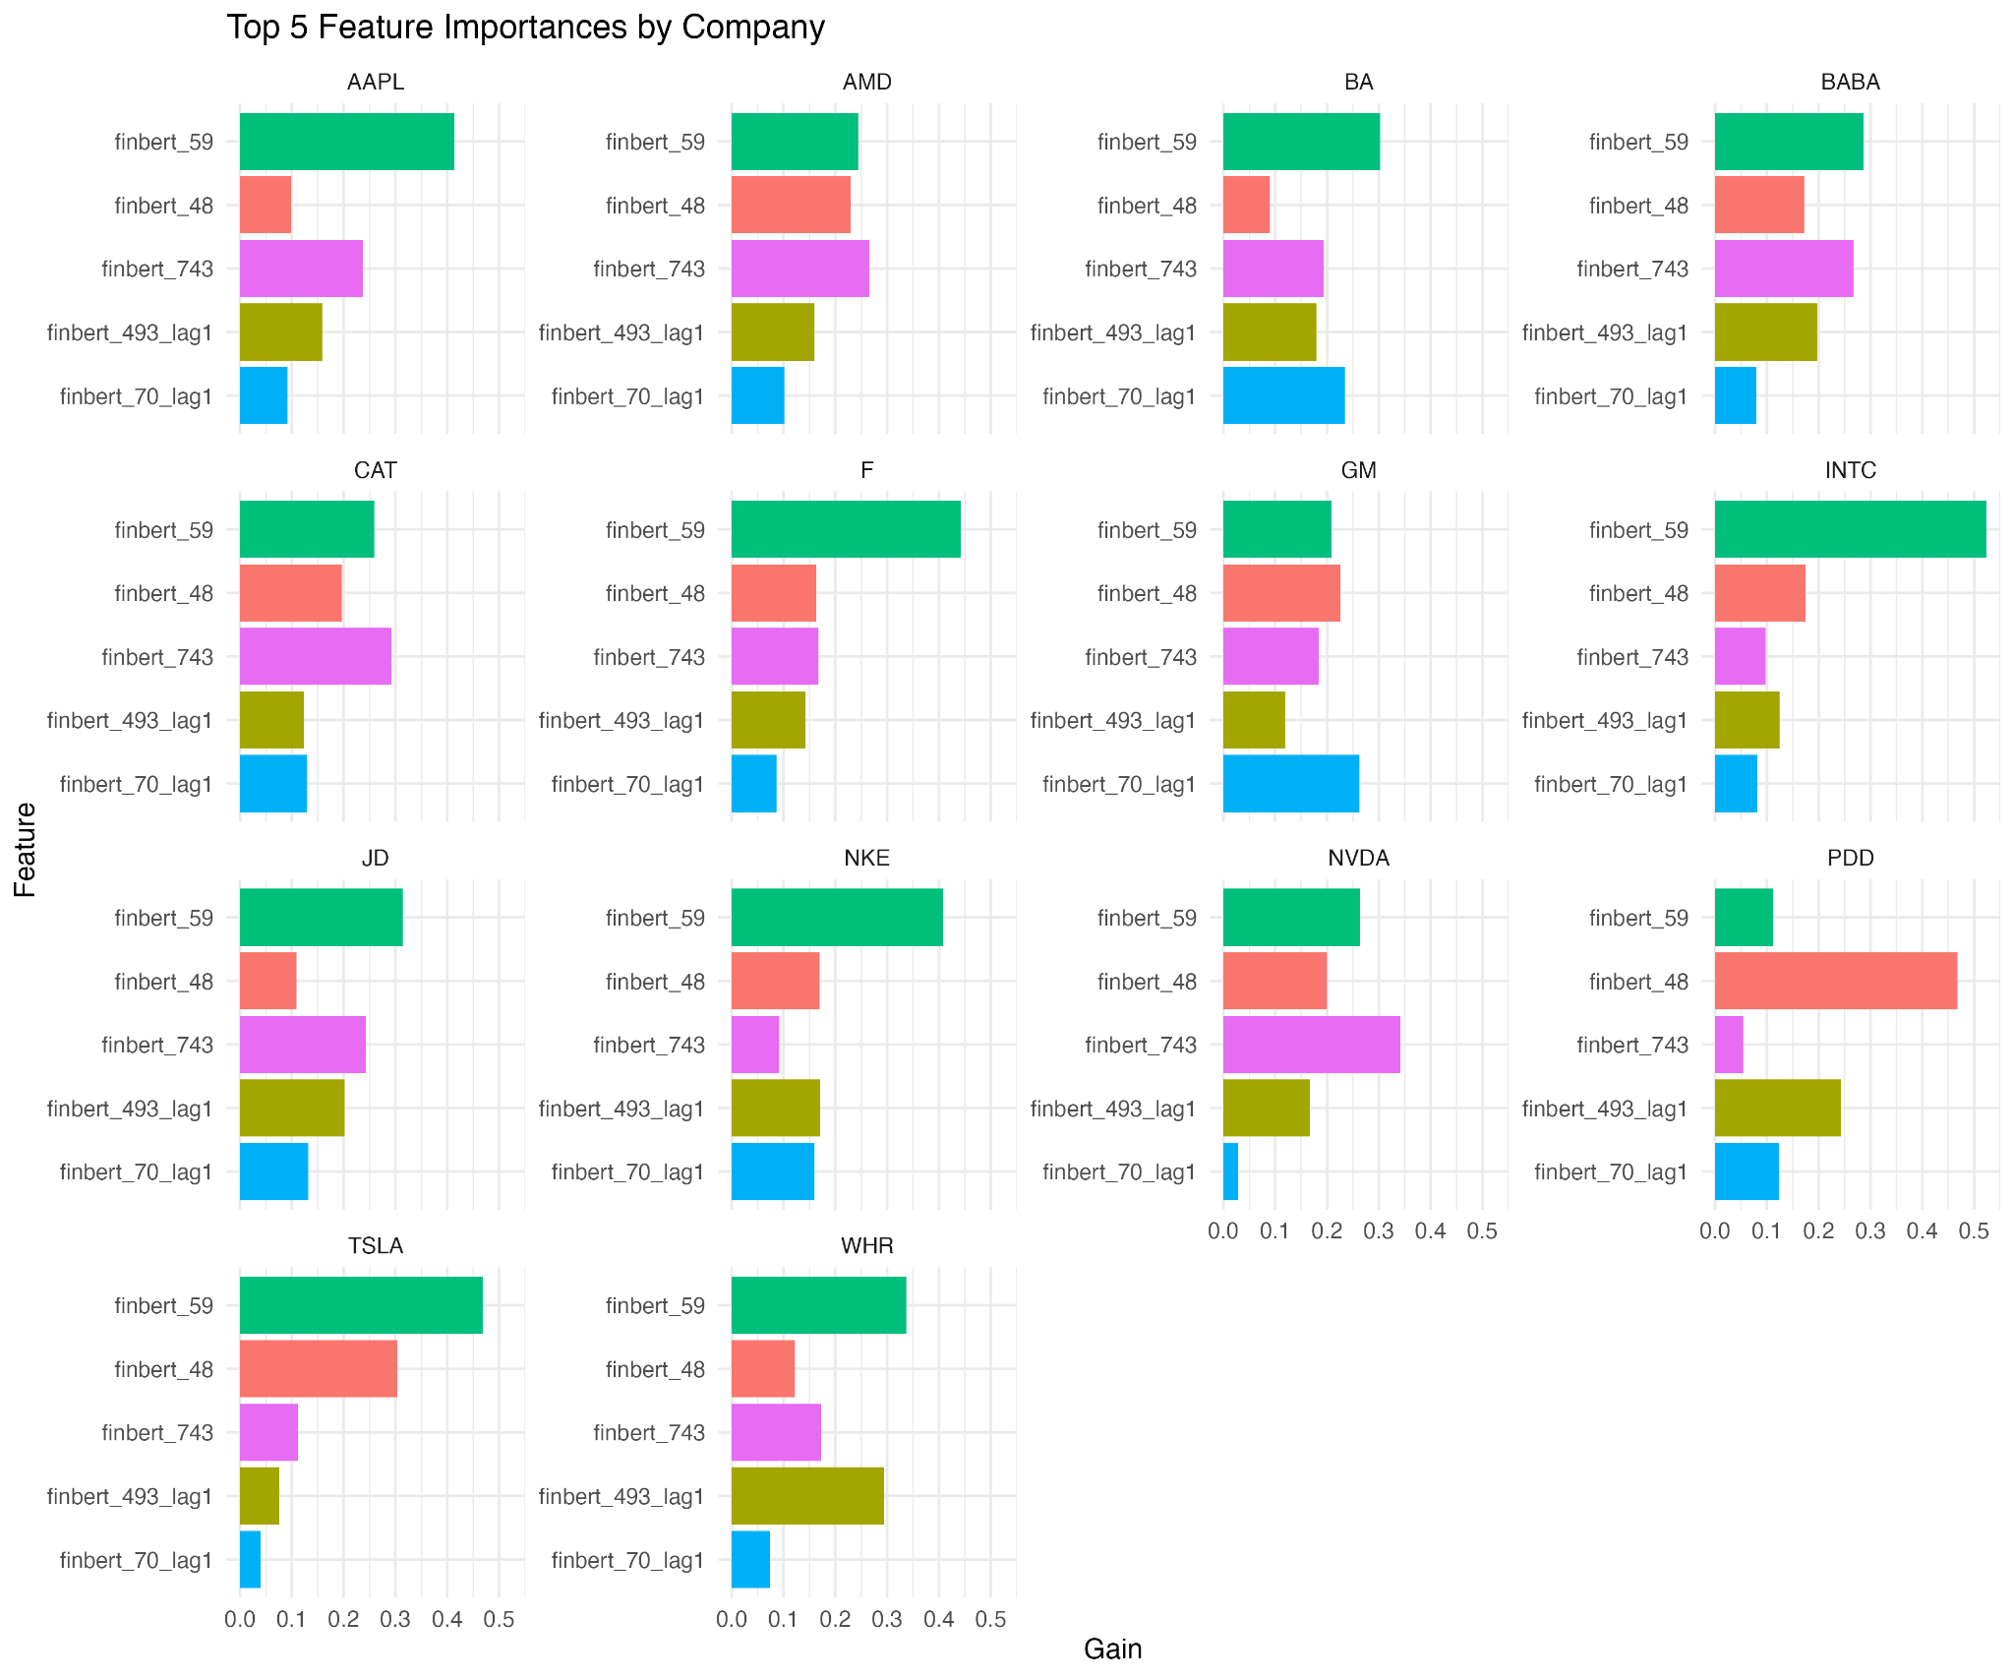
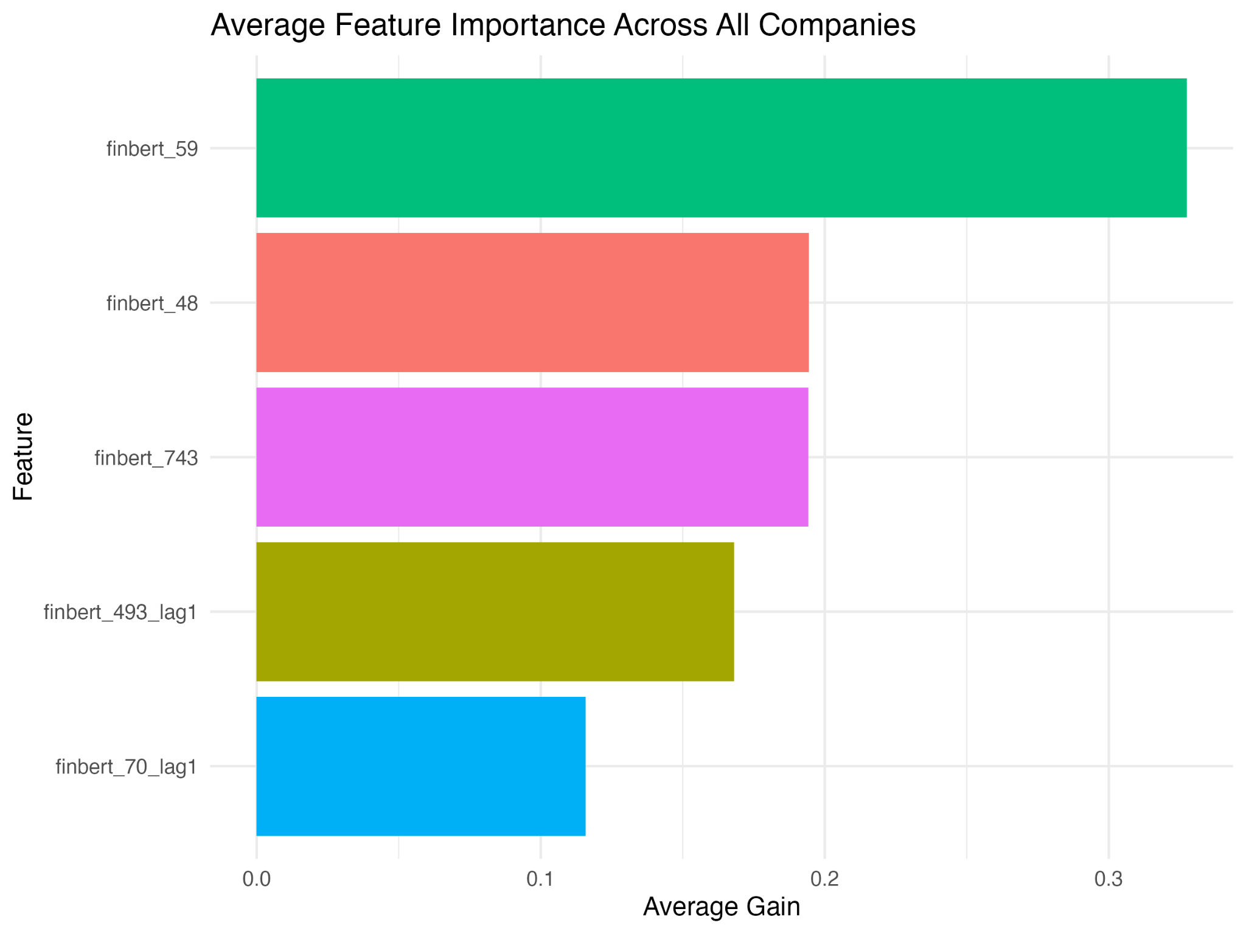
Company-level Analysis-XGBoost

Slide 17
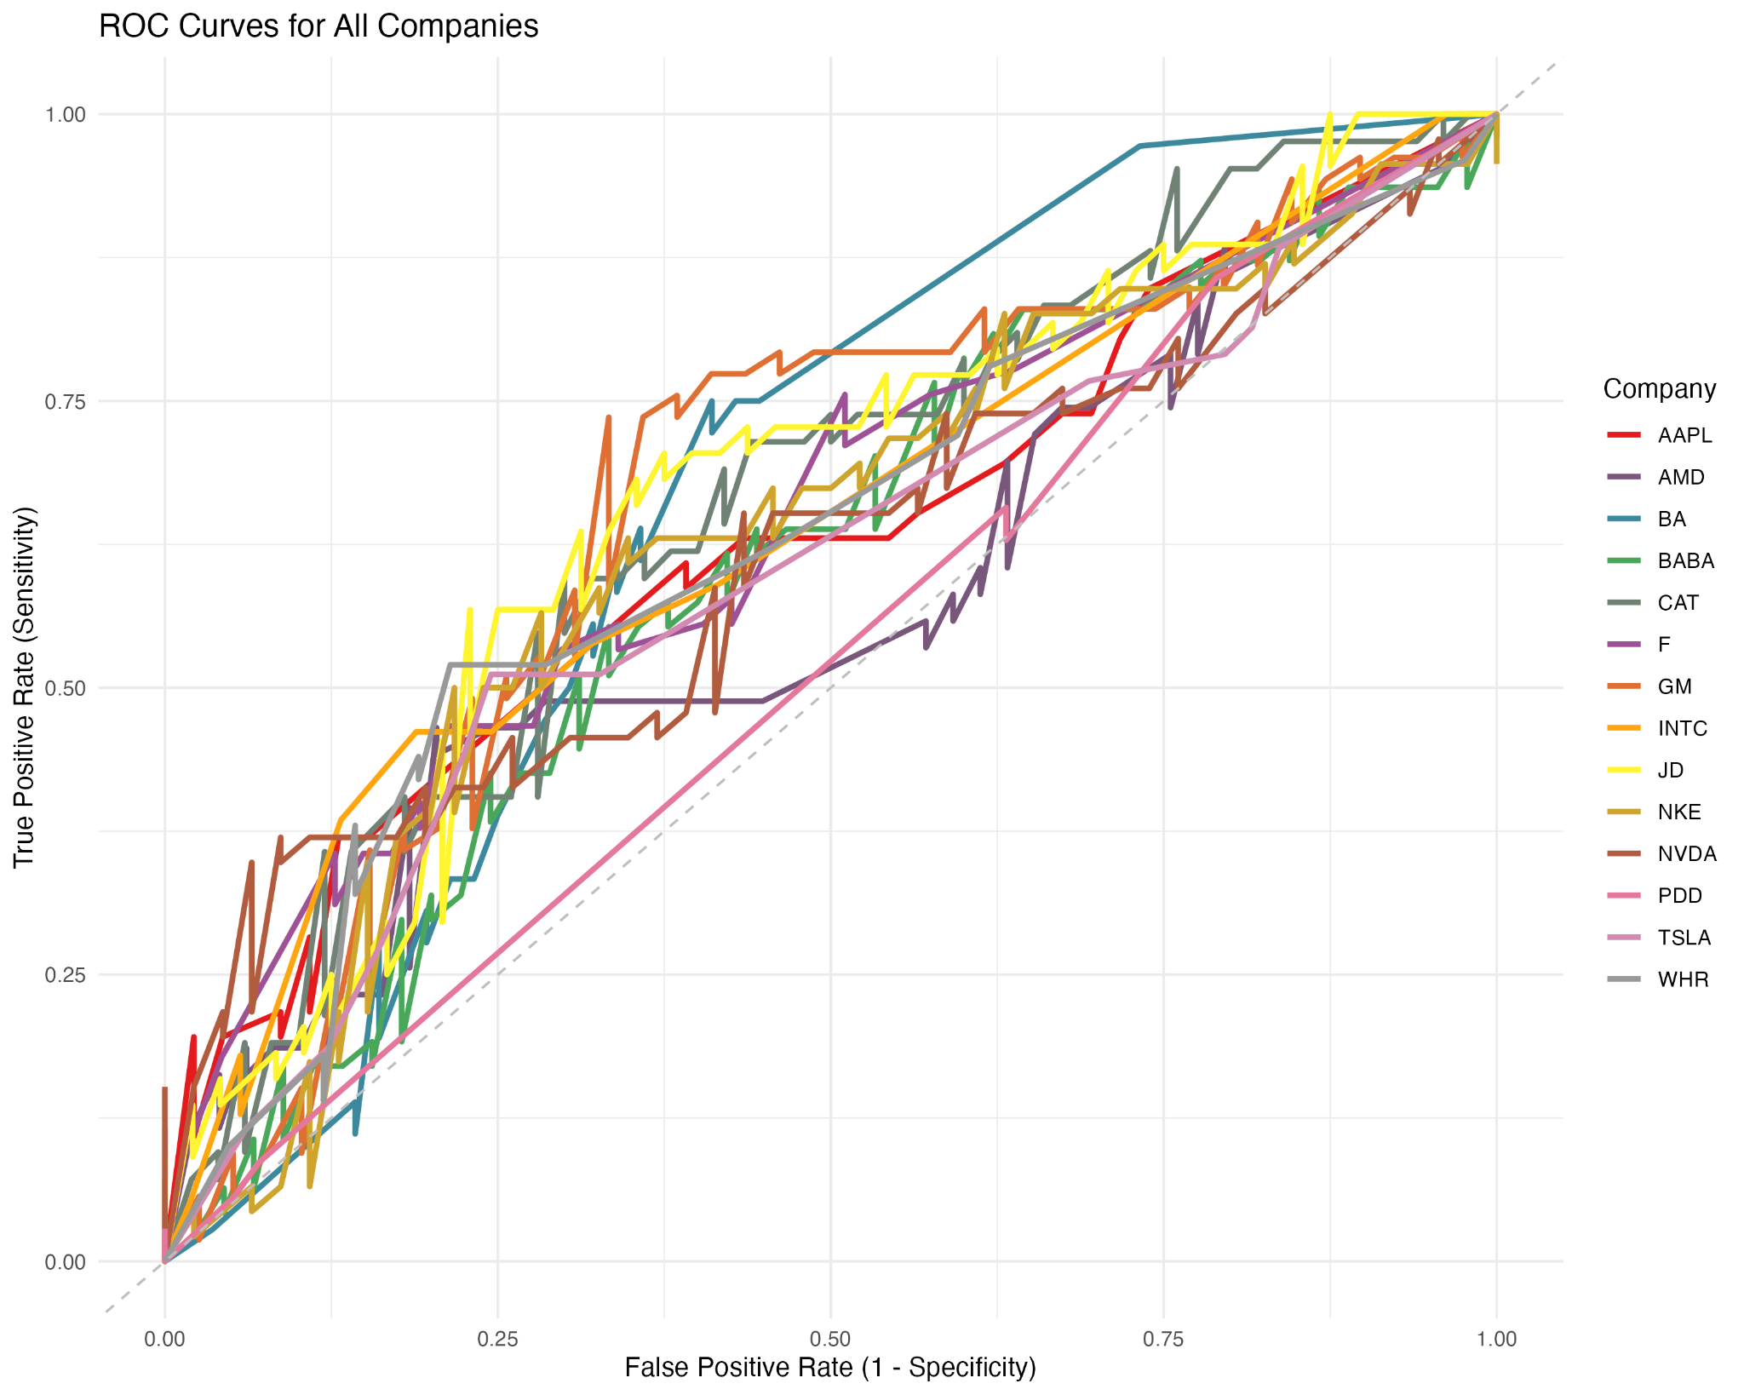

Slide 18
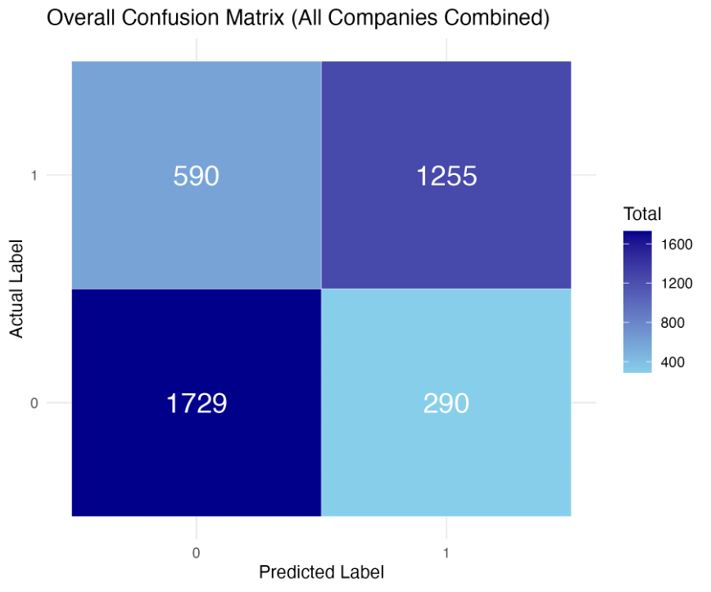
Company | Accuracy | AUC
AAPL | 0.609 | 0.625
TSLA | 0.641 | 0.598
INTC | 0.663 | 0.639
AMD | 0.609 | 0.573
NVDA | 0.598 | 0.612
F | 0.609 | 0.641
GM | 0.685 | 0.662
WHR | 0.609 | 0.627
NKE | 0.63 | 0.625
CAT | 0.652 | 0.66
BA | 0.62 | 0.667
BABA | 0.609 | 0.602
JD | 0.663 | 0.665
PDD | 0.609 | 0.519
XGboost classification results table

Slide 19
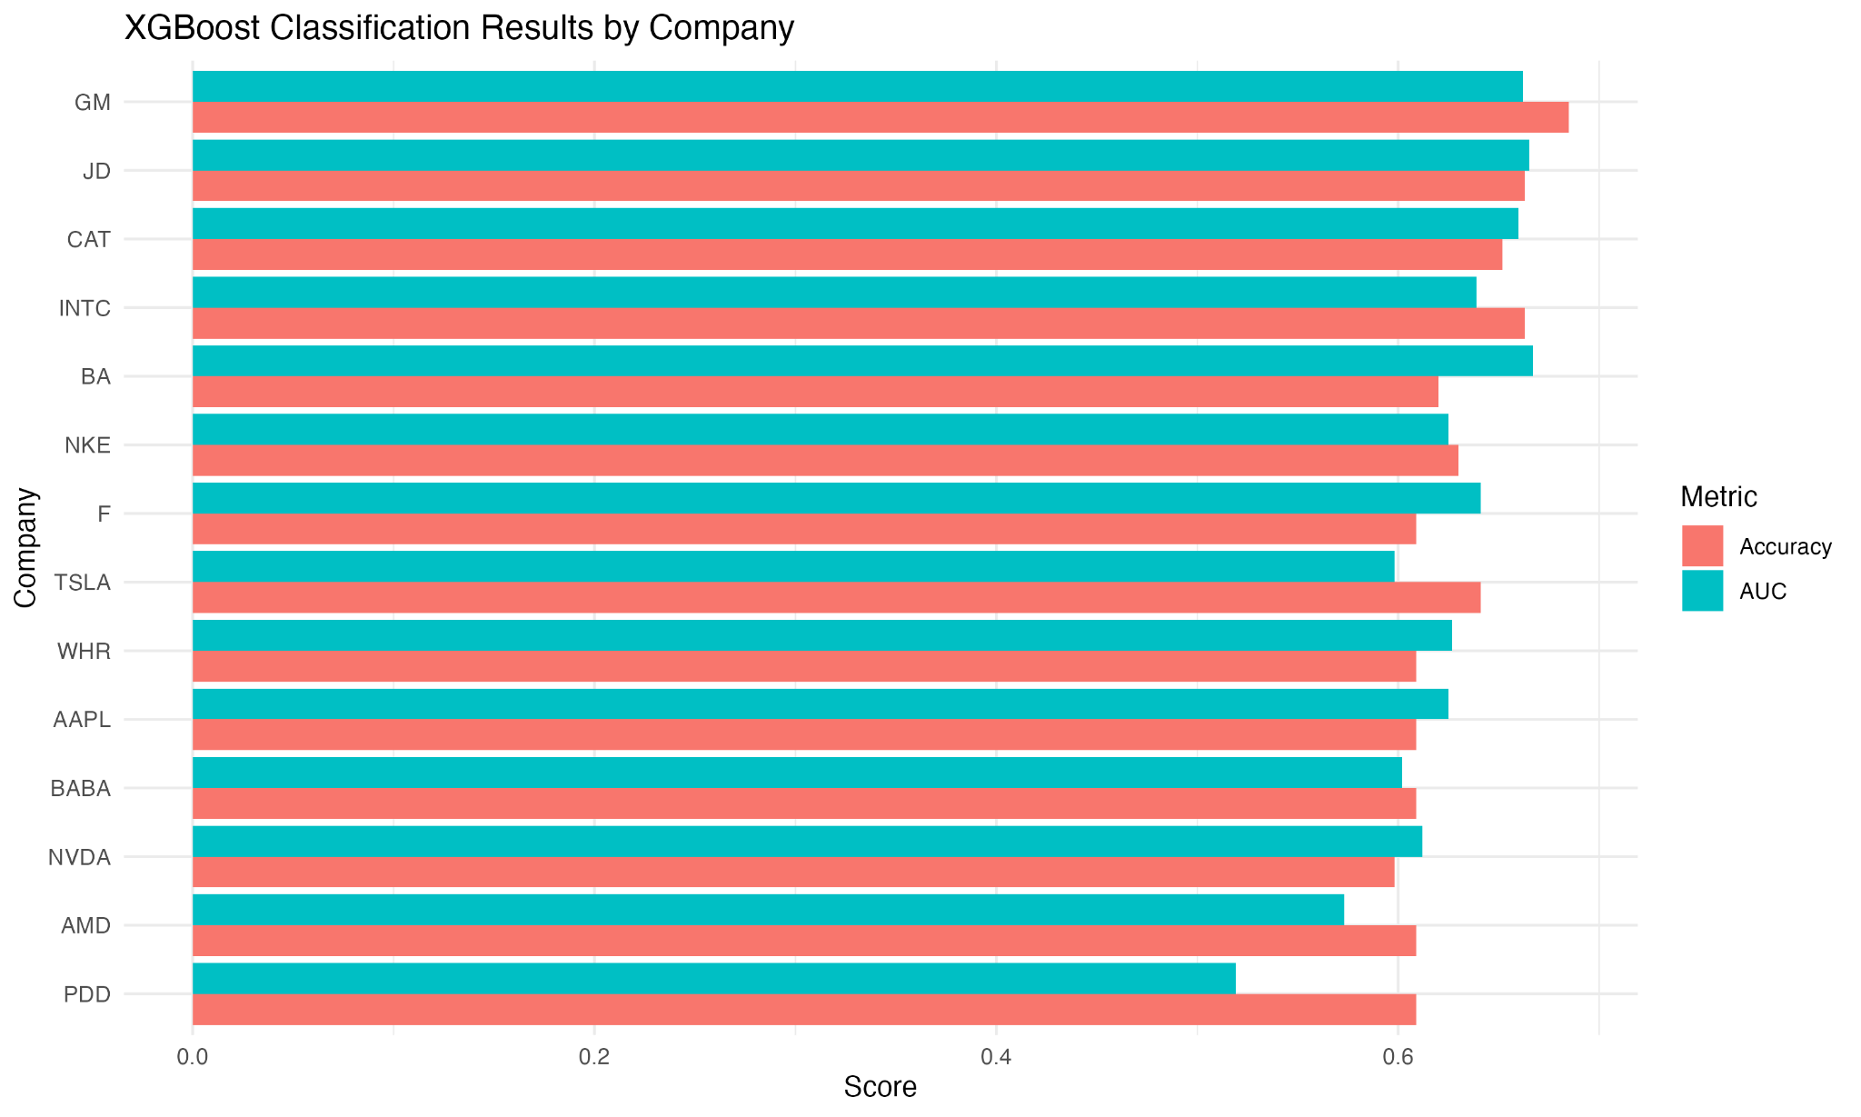

Slide 20
ETF Model Framework
Data Fusion
Merged minute wise ETF price data with FinBERT-based sentiment scores
Aligned on timestamp (release time for sentiment, market time for price)
Three ETFs analyzed: SPY, XLI, DIA
Feature Engineering
Constructed 17 features grouped into:
Price-Based: price range, price change, rolling means/volatility (3d, 5d)
Volume-Based: volume change relative to rolling mean
Sentiment-Based:
Daily metrics (mean, std, count)
Rolling sentiment (3d, 5d)
Sentiment momentum and price impact

Slide 21
ETF Model Framework
Feature Selection (LASSO Regression)
Applied L1-penalized regression to select informative features
Encourages sparse models to reduce overfitting
Retained all features after conservative λ selected no variables
Modeling Approaches
XGBoost: Gradient-boosted trees for nonlinear learning
Random Forest: Bagged trees for stability and robustness
BiLSTM: Neural network to capture sequence patterns in feature time series

Slide 22
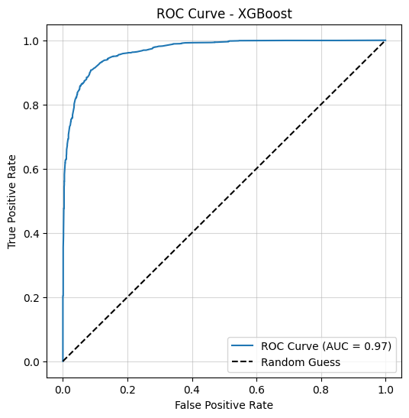
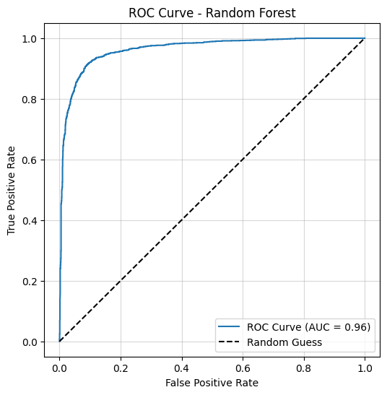
S&P 500 ETF Trust (SPY)
Model | Accuracy | AUC | RMSE
XGBoost | 0.9104 | 0.9692 | 0.2993
Random Forest | 0.9106 | 0.9631 | 0.2989

Slide 23


Industrial Select Sector Fund (XLI)
Model | Accuracy | AUC | RMSE
XGBoost | 0.8977 | 0.9692 | 0.3198
Random Forest | 0.9013 | 0.9587 | 0.3142

Slide 24
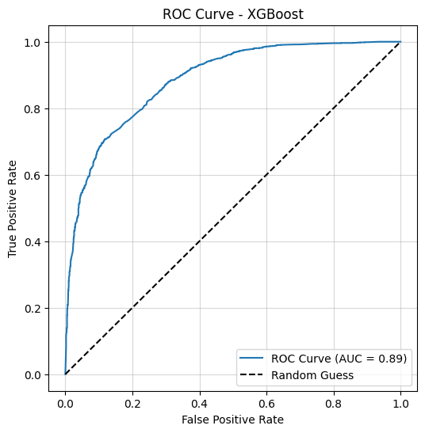
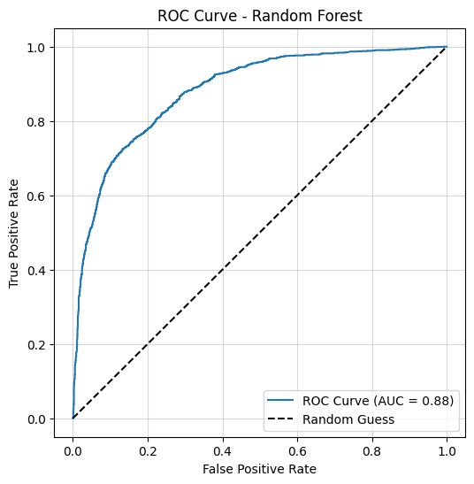
Dow Jones Industrial Average ETF Trust (DIA)
Model | Accuracy | AUC | RMSE
XGBoost | 0.7968 | 0.8854 | 0.4508
Random Forest | 0.7985 | 0.8814 | 0.4489

Slide 25
Conclusion
Financial news, particularly trade policy announcements during the Trump era, had immediate and measurable impacts on both individual stocks and broad ETFs.
FinBERT embeddings outperformed traditional sentiment scores, capturing richer semantic signals.
Limitations:
Time mismatch: Aligning article timestamps and stock data remains imperfect, especially at minute resolution.
Data density: Sparse and uneven distribution of financial news, especially across firms, may affect model reliability.
Model assumptions: FinBERT embeddings may not capture deeper contextual nuances like sarcasm, irony, or implicit tone.
The Road Ahead:
Expand to longer timeframes and more diverse policy events (e.g., monetary, geopolitical).
Incorporate social media, macroeconomic indicators, and multilingual sentiment.
Explore hybrid architectures, combining deep learning and tree-based models, for richer prediction frameworks.

Slide 26
Thank You!

